Slide 1
TDMA
SLOTS 4,5,6,7

Slide 2
Advantages of TDMA
With TDMA, only one carrier uses the transponder at any one time, and therefore, intermodulation products, which result from the nonlinear amplification of multiple carriers, are absent. This leads to one of the most significant advantages of TDMA, which is that the TWT can be operated at maximum power output or saturation level.
Because the signal information is transmitted in bursts, TDMA is only suited to digital signals. Digital data can be assembled into burst format for transmission and reassembled from the received bursts through the use of digital buffer memories.

Slide 3
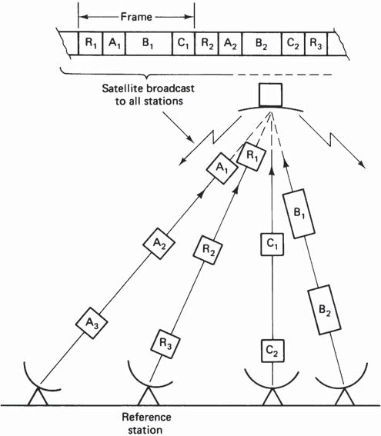
Figure illustrates the basic TDMA concept, in which the stations transmit bursts in sequence
Burst synchronization is required, and in the system illustrated in Fig. one station is assigned solely for the purpose of transmitting reference bursts to which the others can be syn- chromized
The time interval from the start of one reference burst to the next is termed a frame. A frame contains the reference burst R and the bursts from the other earth stations, these being shown as A, B, and C in Fig.
Time-division multiple access (TDMA) using a
reference station for burst synchronization.

Slide 4
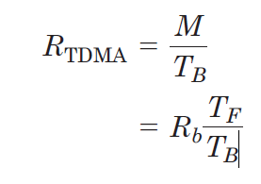
Figure illustrates the basic principles of burst transmission for a single channel. Overall, the transmission appears continuous because the input and output bit rates are continuous and equal.
However, within the transmission channel, input bits are temporarily stored and transmitted in bursts. Since the time interval between bursts is the frame time T_{F}, the required buffer capacity is M = R_{b}T_{F}
The buffer memory fills up at the input bit rate R_{b} during the frame time interval
These M bits are transmitted as a burst in the next frame without any break in continuity of the input. The M bits are transmitted in the burst time T_{B}, and the transmission rate, which is equal to the burst bit rate, is

Slide 5
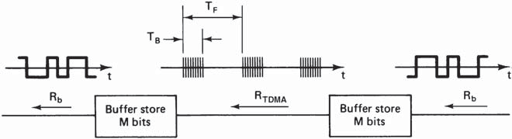
Burst-mode transmission linking two continuous-mode streams

Slide 6
This is also referred to as the burst rate, but note that this means the instantaneous bit rate within a burst (not the number of bursts per second, which is simply equal to 1/TB).
It will be seen that the average bit rate for the burst mode is simply M/TF, which is equal to the input and output rates.
The frame time TF will be seen to add to the overall propagation
delay. For example, in the simple system illustrated in Fig., even
if the actual propagation delay between transmit and receive buffers
is assumed to be zero, the receiving side would still have to wait a time
TF before receiving the first transmitted burst.
The frame period is usually chosen to be a multiple of 125 μs, which is the standard sampling period used in pulse-code modulation (PCM) telephony systems, since this ensures that the PCM samples can be distributed across successive frames at the PCM sampling rate.

Slide 7
Figure shows some of the basic units in a TDMA ground sta- tion, which for discussion purposes is labeled earth station A. Terrestrial links coming into earth station A carry digital traffic addressed to destination stations, labeled B, C, X.
It is assumed that the bit rate is the same for the digital traffic on each terrestrial link. In the units labeled terrestrial interface modules (TIMs), the incoming continuous-bit-rate signals are converted into the intermittent-burst-rate mode. These individual burst-mode signals are time-division multiplexed in the time division multiplexer (MUX) so that the traffic for each destination station appears in its assigned time slot within a burst.
Certain time slots at the beginning of each burst are used to carry timing and synchronizing information. These time slots collectively are referred to as the preamble. The complete burst containing the preamble and the traffic data is used to phase modulate the radiofrequency (rf) carrier. Thus the composite burst which is transmitted at rf consists of a number of time slots, as shown in Fig.

Slide 8
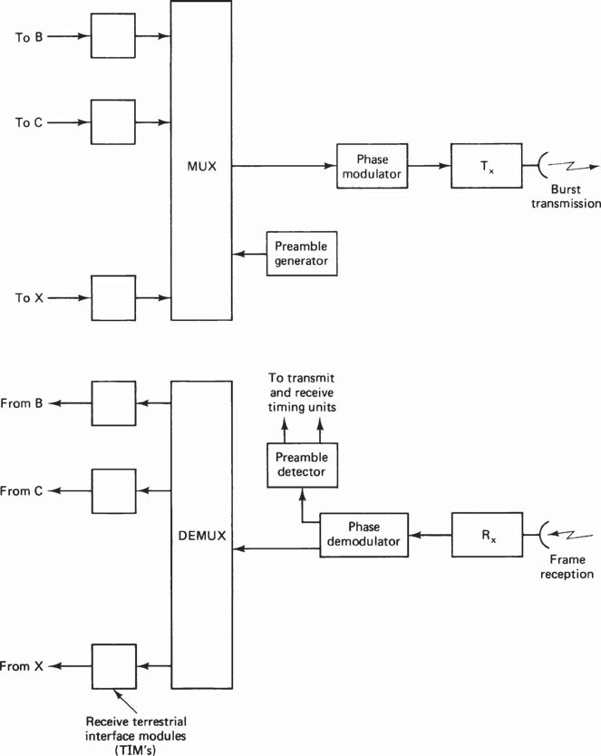
Some of the basic equipment blocks in a TDMA system

Slide 9
The received signal at an earth station consists of bursts from all trans- mitting stations arranged in the frame format shown in Fig. The rf carrier is converted to intermediate frequency (IF), which is then demodulated.
A separate preamble detector provides timing information for transmitter and receiver along with a carrier synchronizing signal for the phase demodulator.
In many systems, a station receives its own transmission along with the others in the frame, which can then be used for burst-timing purposes.
A reference burst is required at the beginning of each frame to provide timing information for the acquisition and synchronization of bursts

Slide 10
In the INTELSAT international network, at least two reference stations are used, one in the East and one in the West. These are designated primary reference stations, one of which is further selected as the master primary.
Each primary station is duplicated by a secondary reference station, making four reference stations in all. The fact that all the reference stations are identical means that any one can become the master primary. All the system timing is derived from the high-stability clock in the master primary which is accurate to 1 part in 10¹¹ .
A clock on the satellite is locked to the master primary, and this acts as the clock for the other participating earth stations. The satellite clock will provide a constant frame time, but the participating earth stations must make corrections for variations in the satellite range, since the transmitted bursts from all the participating earth stations must reach the satellite in synchronism.

Slide 11
In the INTELSAT system, two reference bursts are transmitted in each frame.
The first reference burst, which marks the beginning of a frame, is transmitted by a master primary (or a primary) reference station and contains the timing information needed for the acquisition and synchronization of bursts.
The second reference burst, which is transmitted by a secondary reference station, provides synchronization but not acquisition information. The secondary reference burst is ignored by the receiving earth stations unless the primary or master primary station fails

Slide 12
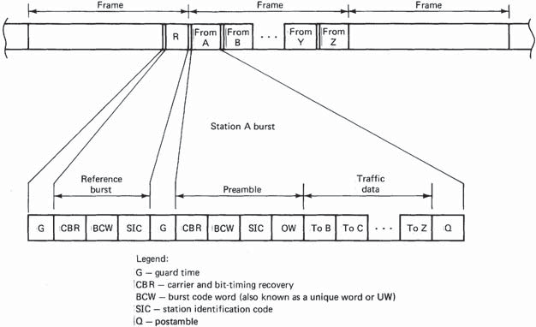
Frame and burst formats for a TDMA system.

Slide 13
Reference burst
The reference burst that marks the beginning of a frame is subdivided into time slots or channels used for various functions.
Guard time (G). A guard time is necessary between bursts to prevent the bursts from overlapping. The guard time will vary from burst to burst depending on the accuracy with which the various bursts can be positioned within each frame.
Carrier and bit-timing recovery (CBR). To perform coherent demod- ulation of the phase-modulated carrier, a coherent carrier signal must first be recovered from the burst. An unmodulated carrier wave is provided during the first part of the CBR time slot. This is used as a synchronizing signal for a local oscillator at the detector, which then produces an output coherent with the carrier wave. The carrier in the subsequent part of the CBR time slot is modulated by a known phase-change sequence which enables the bit timing to be recovered. Accurate bit timing is needed for the operation of the sample-and-hold function in the detector circuit.

Slide 14
Burst code word (BCW). (Also known as a unique word.) This is a binary word, a copy of which is stored at each earth station. By comparing the incoming bits in a burst with the stored version of the BCW, the receiver can detect when a group of received bits matches the BCW, and this in turn provides an accurate time reference for the burst position in the frame. A known bit sequence is also carried in the BCW, which enables the phase ambiguity associated with coher- ent detection to be resolved.
Station identification code (SIC). This identifies the transmitting station.

Slide 15
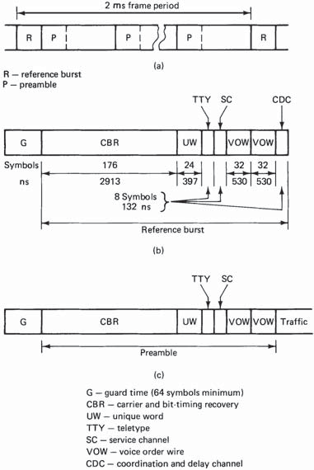
Figure shows the makeup of the reference bursts used in some of the INTELSAT networks. The numbers of symbols and the correspon- ding time intervals allocated to the various functions are shown. In addition to the channels already described, a coordination and delay channel or CDC (sometimes referred to as the control and delay channel) is provided. This channel carries the identification number of the earth station being addressed and various codes used in connection with the acquisition and synchronization of bursts at the addressed earth station. It is also necessary for an earth station to know the propagation time delay to the satellite to implement burst acquisition and synchronization. In the INTELSAT system, the propagation delay is computed from measurements made at the reference station and transmitted to the earth station in question through the coordination and delay channel.
The other channels in the INTELSAT reference burst are the following:
TTY: telegraph order-wire channel, used to provide telegraph com- munications between earth stations.
SC: service channel which carries various network protocol and alarm messages.
VOW: voice-order-wire channel used to provide voice communica- tions between earth stations. Two VOW channels are provided.
Intelsat 2-ms frame;
(b)composition of the reference burst R
(c) composition of the preamble P.

Slide 16
Preamble and postamble
The preamble is the initial portion of a traffic burst that carries information similar to that carried in the reference burst. In some systems the channel allocations in the reference bursts and the preambles are identical. No traffic is carried in the preamble. In Fig the only difference between the preamble and the reference burst is that the preamble provides an orderwire (OW) channel.
For the INTELSAT format shown in fig. the preamble differs from the reference burst in that it does not provide a CDC. Otherwise, the two are identical.
As with the reference bursts, the preamble provides a carrier and bit-timing recovery channel and also a burst-code-word channel for burst-timing purposes. The burst code word in the preamble of a traffic burst is different from the burst code word in the reference bursts, which enables the two types of bursts to be identified.
In certain phase detection systems, the phase detector must be allowed time to recover from one burst before the next burst is received by it. This is termed decoder quenching, and a time slot, referred to as a postamble, is allowed for this function. The postamble is shown as Q in Fig. Many systems are designed to operate without a postamble.

Slide 17
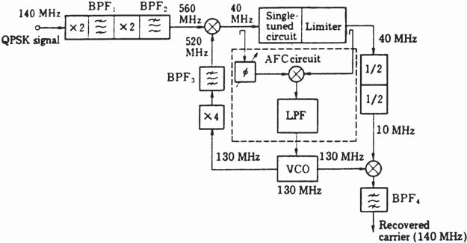
Carrier recovery
A factor, which must be taken into account with TDMA is that the various bursts in a frame lack coherence so that carrier recovery must be repeated for each burst. This applies to the traffic as well as the reference bursts. Where the carrier recovery circuit employs a phase-locked loop such as shown in Fig. a problem known as hangup can occur. This arises when the loop moves to an unstable region of its operating characteristic. The loop operation is such that it eventually returns to a stable operating point, but the time required to do this may be unacceptably long for burst-type signals.
One alternative method utilizes a narrowband tuned circuit filter to recover the carrier. An example of such a circuit for quadrature phaseshift keying (QPSK), taken from Miya (1981), is shown in Fig. The QPSK signal, which has been downconverted to a standard IF of 140 MHz, is quadrupled in frequency to remove the modulation.
The input frequency must be maintained at the resonant frequency of the tuned circuit, which requires some form of automatic frequency control. Because of the difficulties inherent in working with high frequencies, the output frequency of the quadrupler is downconverted from 560 to 40 MHz, and the AFC is applied to the voltage controlled oscil- lator (VCO) used to make the frequency conversion.
The AFC circuit is a form of phase-locked loop (PLL), in which the phase difference between input and output of the single-tuned circuit is held at zero, which ensures that the 40-MHz input remains at the center of the tuned circuit response curve. Any deviation of the phase difference from zero generates a con- trol voltage which is applied to the VCO in such a way as to bring the fre- quency back to the required value.
Interburst interference may be a problem with the tuned-circuit method because of the energy stored in the tuned circuit for any given burst. Avoidance of interburst interference requires careful design of the tuned circuit (Miya, 1981
An example of carrier recovery circuit with a
single-tuned circuit and AFC.
(Courtesy of Miya,
1981.)

Slide 18
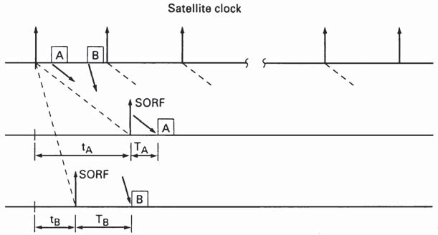
Network synchronization
Network synchronization is required to ensure that all bursts arrive at the satellite in their correct time slots. As mentioned previously, timing markers are provided by the reference bursts, which are tied to a highly stable clock at the reference station and transmitted through the satellite link to the traffic stations. At any given traffic station, detection of the unique word (or burst code word) in the reference burst signals the start of receiving frame (SORF), the marker coinciding with the last bit in the unique word.
It would be desirable to have the highly stable clock located aboard the satellite because this would eliminate the variations in propagation delay arising from the uplink for the reference station, but this is not practical because of weight and space limitations. However, the reference bursts retransmitted from the satellite can be treated, for timing purposes, as if they originated from the satellite (Spilker, 1977).
The network operates what is termed a burst time plan, a copy of which is stored at each earth station. The burst time plan shows each earth station where the receive bursts intended for it are relative to the SORF marker. This is illustrated in Fig. At earth station A the SORF marker is received after some propagation delay t_{A}, and the burst time plan tells station A that a burst intended for it follows at time T_{A} after the SORF marker received by it. Likewise, for station B, the propagation delay is t_{B}, and the received bursts start at T_{B} after the SORF markers received at station B. The propagation delays for each station will differ, but typically they are in the region of 120 ms each.
The burst time plan also shows a station when it must transmit its bursts in order to reach the satellite in the correct time slots. A major advantage of the TDMA mode of operation is that the burst time plan is essentially under software control so that changes in traffic patterns can be accommodated much more readily than is the case with FDMA, where modifications to hardware are required. Against this, imple- mentation of the synchronization is a complicated process.
Corrections must be included for changes in propagation delay which result from the slowly varying position of the satellite In general, the procedure for transmit timing control has two stages. First, there is the need for a station just entering, or reentering after a long delay, to acquire its correct slot position, this being referred to as burst position acquisition. Once the time slot has been acquired, the traffic station must maintain the correct position, this being known as burst position synchronization.
Start of receive frame (SORF) marker in a time burst plan

Slide 19
Open-loop timing control. This is the simplest method of transmit timing. A station transmits at a fixed interval following reception of the timing markers, according to the burst time plan, and sufficient guard time is allowed to absorb the variations in propagation delay. The burst position error can be large with this method, and longer guard times are necessary, which reduces frame efficiency .
However, for frame times longer than about 45 ms, the loss of efficiency is less than 10 percent. In a modified version of the open-loop method known as adaptive open-loop timing, the range is computed at the traffic station from orbital data or from measurements, and the traffic earth station makes its own corrections in timing to allow for the variations in the range. It should be noted that with open-loop timing, no special acqui- sition procedure is required.

Slide 20
Loopback timing control. Loopback refers to the fact that an earth sta- tion receives its own transmission, from which it can determine range. It follows that the loopback method can only be used where the satellite transmits a global or regional beam encompassing all the earth stations in the network. A number of methods are available for the acquisition process (see, for example, Gagliardi, 1991), but basically, these all require some form of ranging to be carried out so that a close estimate of the slot position can be acquired.
In one method, the traffic station transmits a low-level burst consisting of the preamble only. The power level is 20 to 25 dB below the normal operating level (Ha, 1990) to prevent interference with other bursts, and the short burst is swept through the frame until it is observed to fall within the assigned time slot for the station.
The short burst is then increased to full power, and fine adjustments in timing are made to bring it to the beginning of the time slot. Acquisition can take up to about 3 s in some cases. Following acquisition, the traffic data can be added, and synchronization can be maintained by continuously monitoring the position of the loopback transmission with reference to the SORF marker. The timing positions are reckoned from the last bit of the unique word in the preamble (as is also the case for the reference burst). The loopback method is also known as direct closed-loop feedback.

Slide 21
Feedback timing control. Where a traffic station lies outside the satel- lite beam containing its own transmission, loopback of the transmis- sion does not of course occur, and some other method must be used for the station to receive ranging information. Where the synchronization information is transmitted back to an earth station from a distant station, this is termed feedback closed-loop control.
The distant station may be a reference station, as in the INTELSAT network, or it may be another traffic station which is a designated partner. During the acquisition stage, the distant station can feed back information to guide the positioning of the short burst, and once the correct time slot is acquired, the necessary synchronizing information can be fed back on a contin- uous basis.

Slide 22
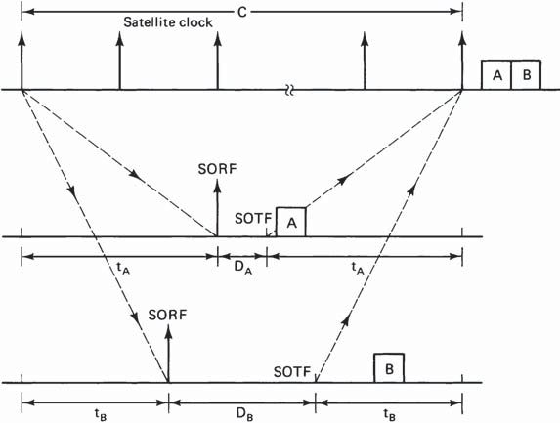
Figure illustrates the feedback closed-loop control method for two earth stations A and B. The SORF marker is used as a reference point for the burst transmissions. However, the reference point which denotes the start of transmit frame (SOTF) has to be delayed by a certain amount, shown as D_{A} for earth station A and D_{B} for earth-station B.
This is necessary so that the SOTF reference points for each earth station coincide at the satellite transponder, and the traffic bursts, which are transmitted at their designated times after the SOTF, arrive in their correct relative positions at the transponder, as shown in Fig.
The total time delay between any given satellite clock pulse and the corresponding SOTF is a constant, shown as C in Fig. C is equal to 2t_{A} + D_{A} for station A and 2t_{B} + D_{B} for station B. In general, for earth station i, the delay D_{i} is determined by
2t_{i} + D_{i} = C
In the INTELSAT network, C = 288 ms.
Timing relationships in a TDMA system. SORF, start of receive frame; SOTF, start of transmit frame

Slide 23
For a truly geostationary satellite, the propagation delay t_{i} would be constant. However, station-keeping maneuvers are required to keep a geostationary satellite at its assigned orbital position, and hence this position can be held only within certain tolerances. For example, in the INTELSAT network, the variation in satel- lite position can lead to a variation of up to ±0.55 ms in the propagation delay (INTELSAT, 1980).
In order to minimize the guard time needed between bursts, this variation in propagation delay must be taken into account in determining the delay, D_{i}, required at each traffic station. In the INTELSAT network, the D_{i} numbers are updated every 512 frames, which is a period of 1.024 s, based on measurements and calculations of the propagation delay times made at the reference station.
The D_{i} numbers are transmitted to the earth stations through the CDC channel in the reference bursts. (It should be noted that the open-loop synchronization described previously amounts to using a constant D_{i} value.)
The use of traffic burst preambles along with reference bursts to achieve synchronization is the most common method, but at least one other method, not requiring preambles, has been proposed by Nuspl and de Buda (1974). It also should be noted that there are certain types of “packet satellite networks,” for example, the basic Aloha system (Rosner, 1982), which are closely related to TDMA, in which synchronization is not used.

Slide 24
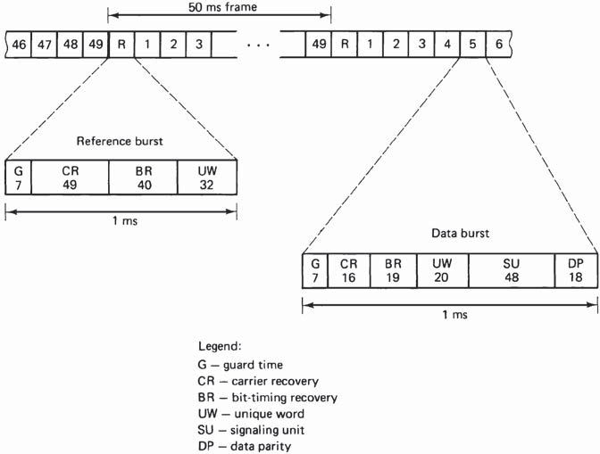
Preassigned TDMA
An example of a preassigned TDMA network is the CSC for the Spade network. The frame and burst formats are shown in Fig. The CSC can accommodate up to 49 earth stations in the network plus one reference station, making a maximum of 50 bursts in a frame.
All the bursts are of equal length. Each burst contains 128 bits and occupies a 1-ms time slot. Thus the bit rate is 128 kb/s.the frequency bandwidth required for the CSC is 160 kHz.
The signaling unit (SU) shown in Fig. s that section of the data burst which is used to update the other stations on the status of the frequencies available for the SCPC calls. It also carries the signaling infor mation.
Frame and bit formats for the common signaling
channel (CSC) used with the Spade system. (Data from Miya, 1981.)

Slide 25
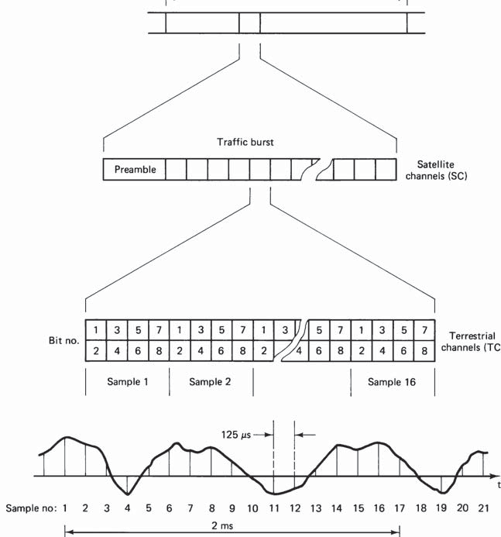
Another example of a preassigned TDMA frame format is the INTELSAT frame shown in simplified form in Fig. In the INTELSAT system, preassigned and demand-assigned voice channels are carried together, but for clarity, only a preassigned traffic burst is shown.
The traffic burst is subdivided into time slots, termed satellite channels in the INTELSAT terminology, and there can be up to 128 of these in a traffic burst.
Each satellite channel is further subdivided into 16 time slots termed terrestrial channels, each terrestrial channel carry- ing one PCM sample of an analog telephone signal.
QPSK modulation is used, and therefore, there are 2 bits per symbol as shown. Thus each terrestrial channel carries 4 symbols (or 8 bits). Each satellite channel carries 4 × 16 = 64 symbols, and at its maximum of 128 satellite chan- nels, the traffic burst carries 8192 symbols.
Preassigned TDMA frame in the Intelsat system.

Slide 26
As discussed the PCM sampling rate is 8 kHz, and with 8 bits per sample, the PCM bit rate is 64 kb/s. Each satellite channel can accommodate this bit rate. Where input data at a higher rate must be transmitted, multiple satellite channels are used. The maximum input data rate which can be handled is 128(SC) × 64 kb/s = 8.192 Mb/s.
The INTELSAT frame is 120,832 symbols or 241,664 bits long. The frame period is 2 ms, and therefore, the burst bit rate is 120.832 Mb/s. As mentioned previously, preassigned and demand-assigned voice channels can be accommodated together in the INTELSAT frame format. The demand-assigned channels utilize a technique known as digital speech interpolation (DSI).
The preassigned channels are referred to as digital noninterpolated(DNI) channels.

Slide 27
Demand-assigned TDMA
With TDMA, the burst and subburst assignments are under software control, compared with hardware control of the carrier frequency assignments in FDMA. Consequently, compared with FDMA networks, TDMA networks have more flexibility in reassigning channels, and the changes can be made more quickly and easily.
A number of methods are available for providing traffic flexibility with TDMA. The burst length assigned to a station may be varied as the traffic demand varies. A central control station may be employed by the network to control the assignment of burst lengths to each participat- ing station. Alternatively, each station may determine its own burst- length requirements and assign these in accordance with a prearranged network discipline.
As an alternative to burst-length variation, the burst length may be kept constant and the number of bursts per frame used by a given station varied as demand requires.
In one proposed system (CCIR Report 708, 1982), the frame length is fixed at 13.5 ms. The basic burst time slot is 62.5 μs, and stations in the network transmit information bursts varying in discrete steps over the range 0.5 ms (8 basic bursts) to 4.5 ms (72 basic bursts) per frame.
Demand assignment for speech channels takes advantage of the intermittent nature of speech.

